Slide 1
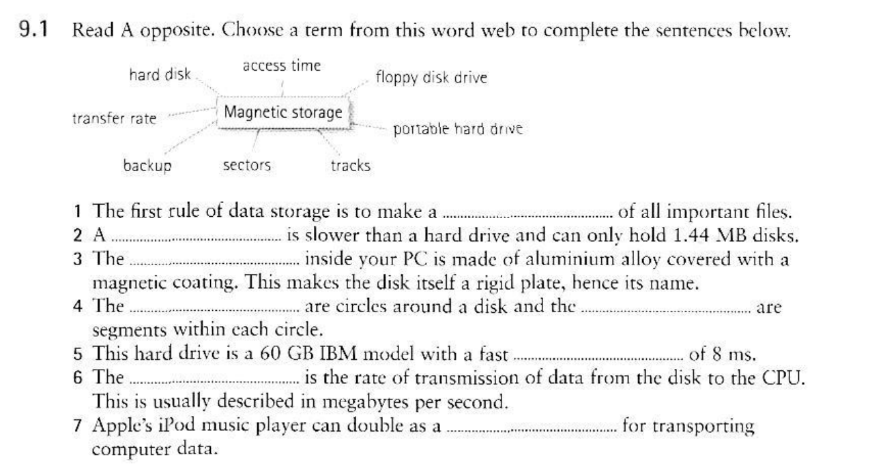
1. The first rule of data storage is to make a backup of all important files.
2. A floppy disk drive is slower than a hard drive and can only hold 1.44 MB disks.
3. The hard disk inside your PC is made of aluminium alloy covered with a magnetic coating. This makes the disk itself a rigid plate, hence its name.
4. The tracks are circles around a disk and the sectors are segments within each circle.
5. This hard drive is a 60 GB IBM model with a fast transfer rate of 8ms.
6. The access time is the rate of transmission of data from the disk to the CPU. This is usually described in megabytes per second.
7. Apple’s iPod music player can double as a portable hard drive for transporting computer data.
RENZO NEYRA QUESQUEN

Slide 2
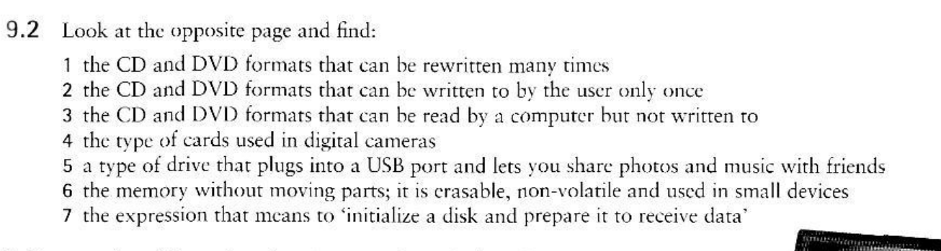

CD – RW and DVD-RW or DVD+RW
CD – R and DVD-R or DVD+RW
CD – ROMs and DVD-ROM
COMPACTFLASH CARDS
FLASH DRIVES
FLASH MEMORY
FORMAT THE DISK
RENZO NEYRA QUESQUEN

Slide 3
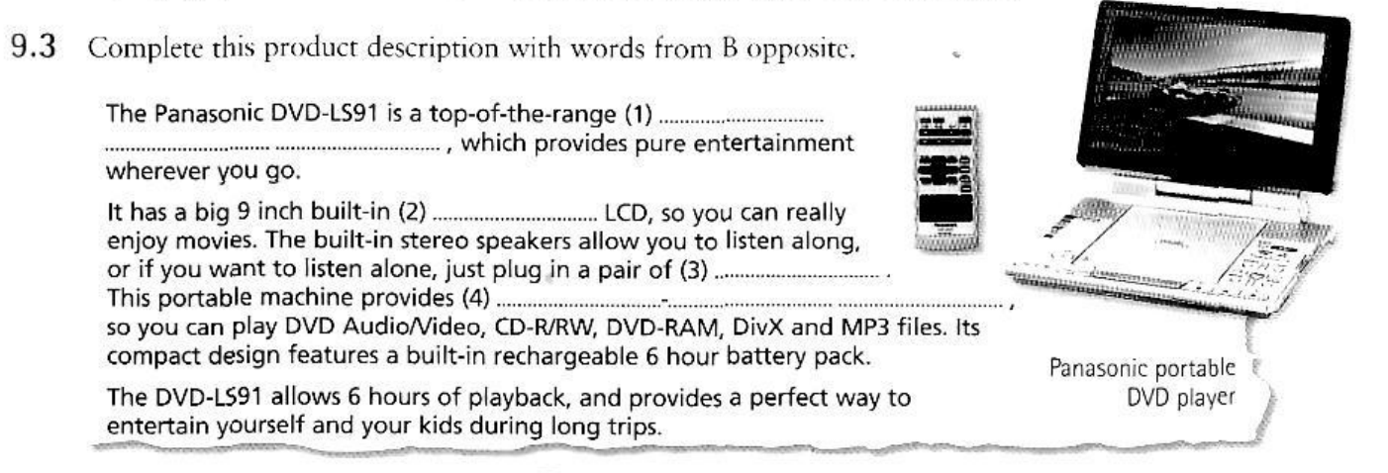
The Panasonic DVD-LS91 is a top-of-the-range portable DVD player, which provides pure entertainment wherever you go. It has a big 9-inch built-in widescreen LCD, so you can really enjoy movies. The built-in stereo speakers allow you to listen along, or if you want to listen alone, just plug in a pair of headphones. This portable machine provides versatility, so you can play DVD Audio/Video, CD-R/RW, DVD-RAM, DivX, and MP3 files. Its compact design features a built-in rechargeable 6-hour battery pack.
RENZO NEYRA QUESQUEN

